Slide 1
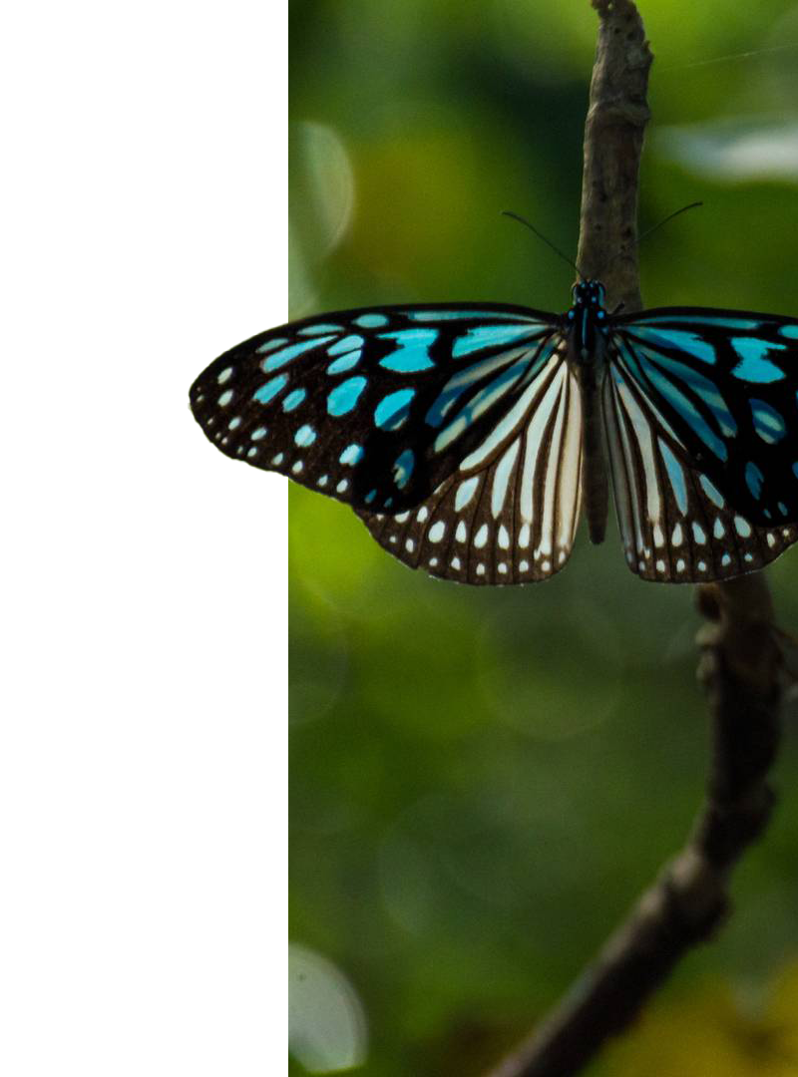

Collecting and modeling semi-structured data on food supplements with botanical ingredients on the online market in Ireland
Shravya Shree Gali (22057528)
MSc Data Science and Statistical Learning

Slide 2

Background
What are botanicals in food supplements?
Herbal or plant based dietary supplements
Ex: tea, garlic, evening primrose oil
Used in medicine from centuries

Slide 3
However…
Some can cause adverse effects
Mitragyna speciosa (Kratom)
A treatment for opiate symptoms of withdrawal
Multiorgan toxicity and cardiotoxicity

Slide 4

EFSA
European Food Safety Authority
Conduct risk assessments
Scientific views on food safety issues
Compendium of Botanicals: List of botanicals that may be harmful to human health when used in food and food supplements

Slide 5

Research Questions
01
02
03
04
How many food supplement products contain botanicals which are potentially harmful ?
Can we predict if a product is potentially harmful solely based on its composition excluding any harmful botanicals ?
Can the products be clustered into groups based on their composition ?
Do harmful products favor one cluster more than the other ?

Slide 6
Methodology
Web Scraping
Text Processing
Exploratory Data Analysis
Modelling

Slide 7
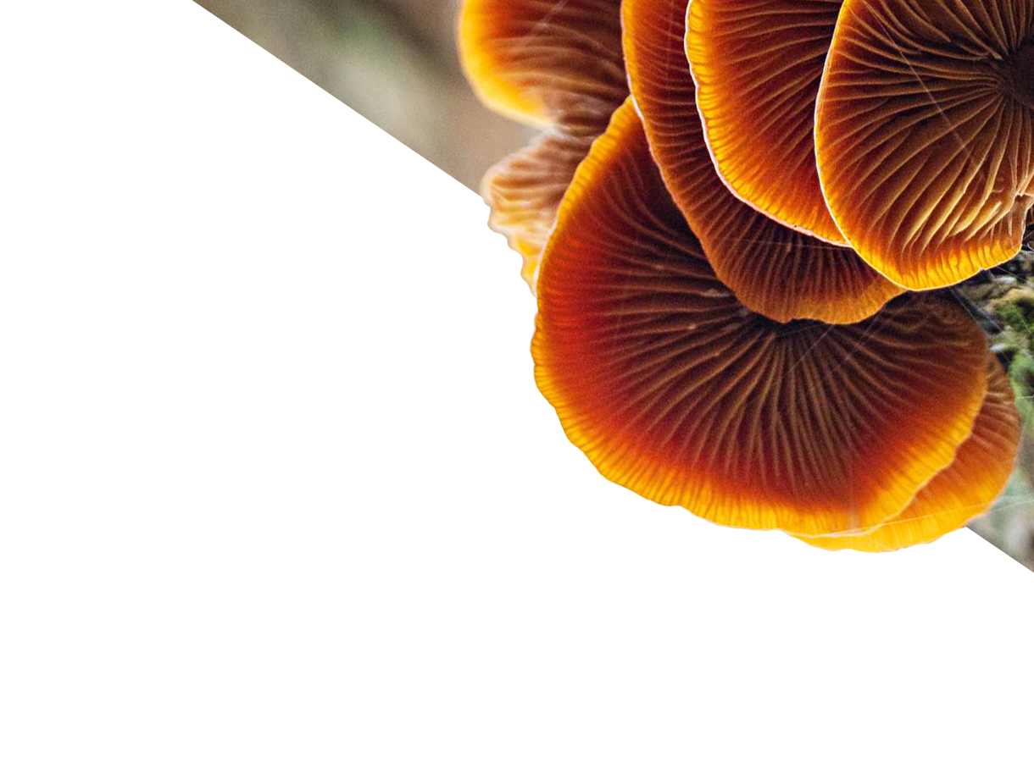
Web Scraping
Beautiful Soup
Selenium
Scrapy
Good for small requests
Simpler functions like find elements with class id
Cannot handle high volume
Contains java script features
Useful in clicking buttons and other java script elements
Slow
Specifically built for web Scraping
Framework with spiders and crawl function
Features like auto throttle and read robots.txt

Slide 8

Scrapy
Creating Spiders
Crawling web
A python program
2 main functions for product list scraping and product detail scraping
Contains code to find elements, scrape and save data
Command line
Runs the spider using URL links
Information scraped
Product name
Ingredients text

Slide 9
Issues
Web page HTML is not consistent
Websites do not want to be scraped (Robots.txt)
Server issues
Pagination variability
Infinite scrolling
Ingredients text is not available for the product

Slide 10
Text Processing
Need
Regular expressions
Some rules used
Some of the ingredients text is blank or unusable
Ingredients text is not in the required form
Unnecessary words and characters
’re’ python package
Finds string which match given rules
Efficient for cleaning text data
Remove words within parenthesis
Remove special characters
Remove stop words
10

Slide 11
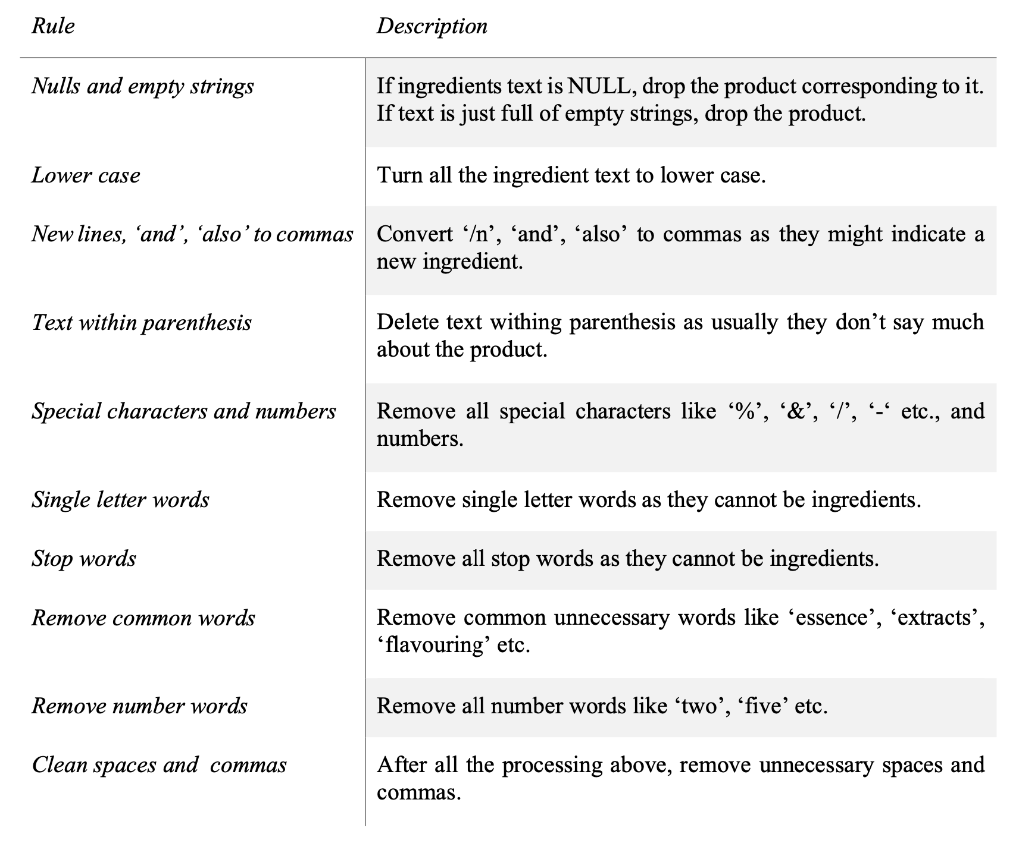
Rules used to clean data

Slide 12
Exploratory Data Analysis
Frequencies of ingredients
Correlations between ingredients
Statistically significant ingredients
12

Slide 13
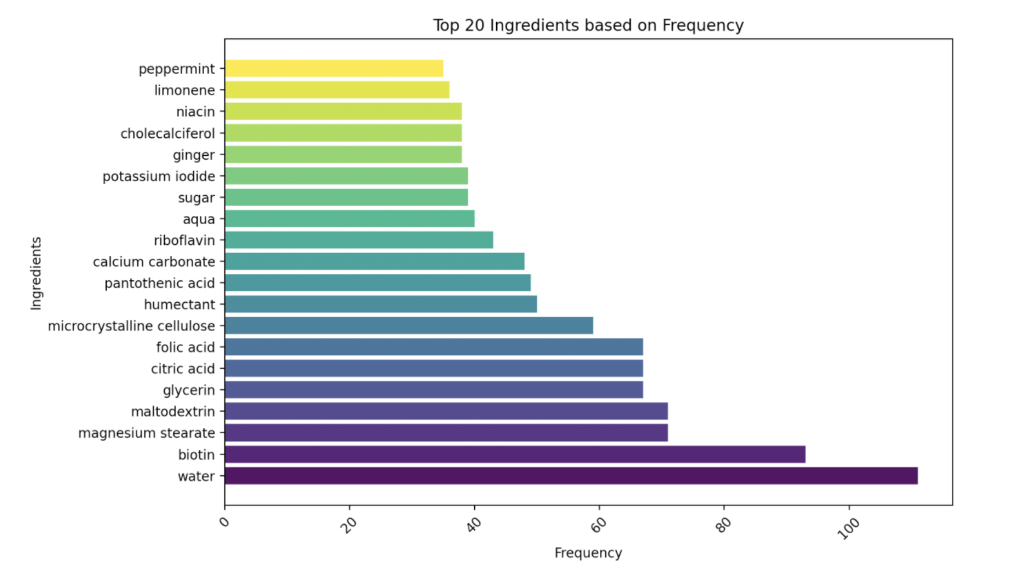

Slide 14
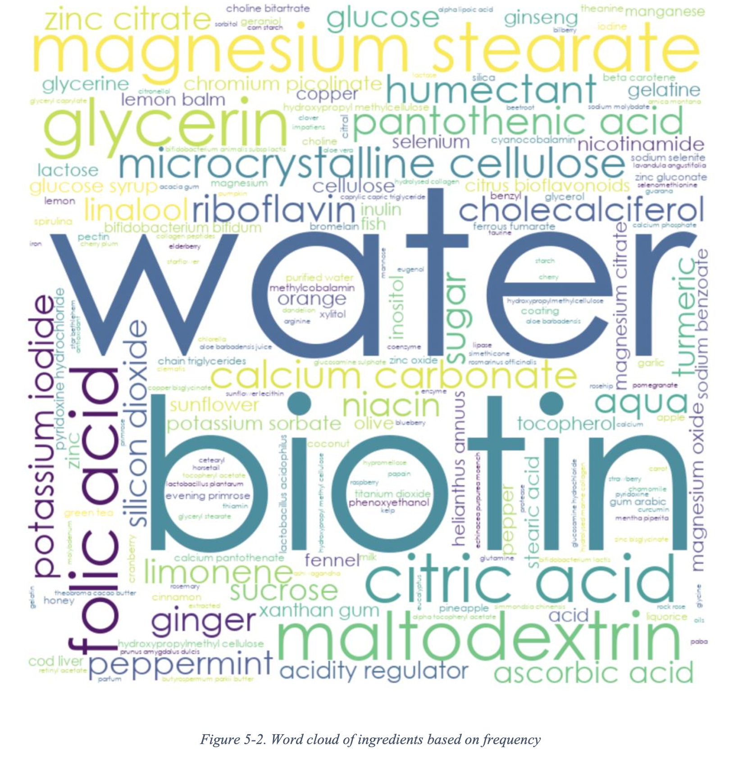
Word Cloud of Ingredients based on frequency

Slide 15
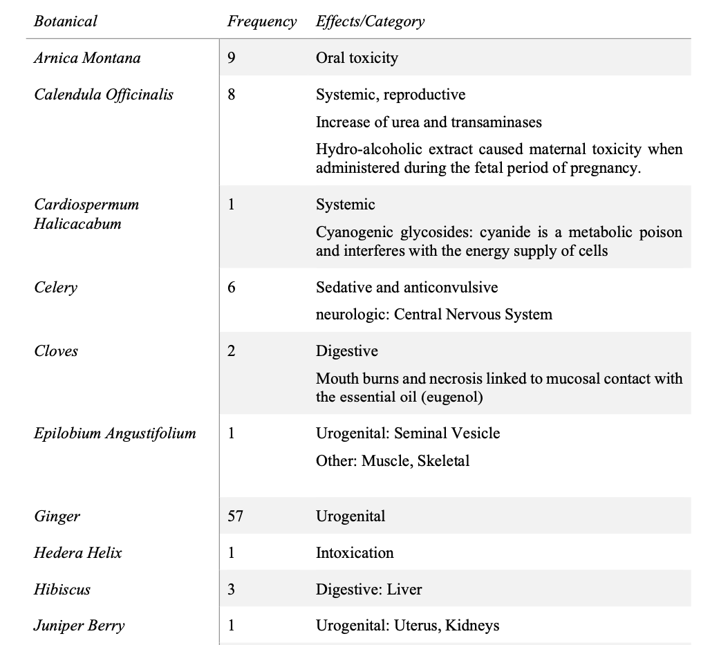
Potentially harmful botanicals found in products

Slide 16
Modelling
Logistic regression with feature selection
Penalized logistic regression
K-means clustering
16

Slide 17
Classification model
Logistic regression with feature selection
Penalized logistic regression
Techniques
Based on frequency
Based on correlation with target variable
Based on statistically significant ingredients
Lasso regularization
Ridge regularization
Oversampling
K-fold cross validation
Performance measurement using Accuracy, Precision, Recall, F1-score, ROC curve and confusion matrix.
17

Slide 18
K-means clustering
Problems with high dimensional data
Principal factors
Elbow method to find optimal clusters
18

Slide 19
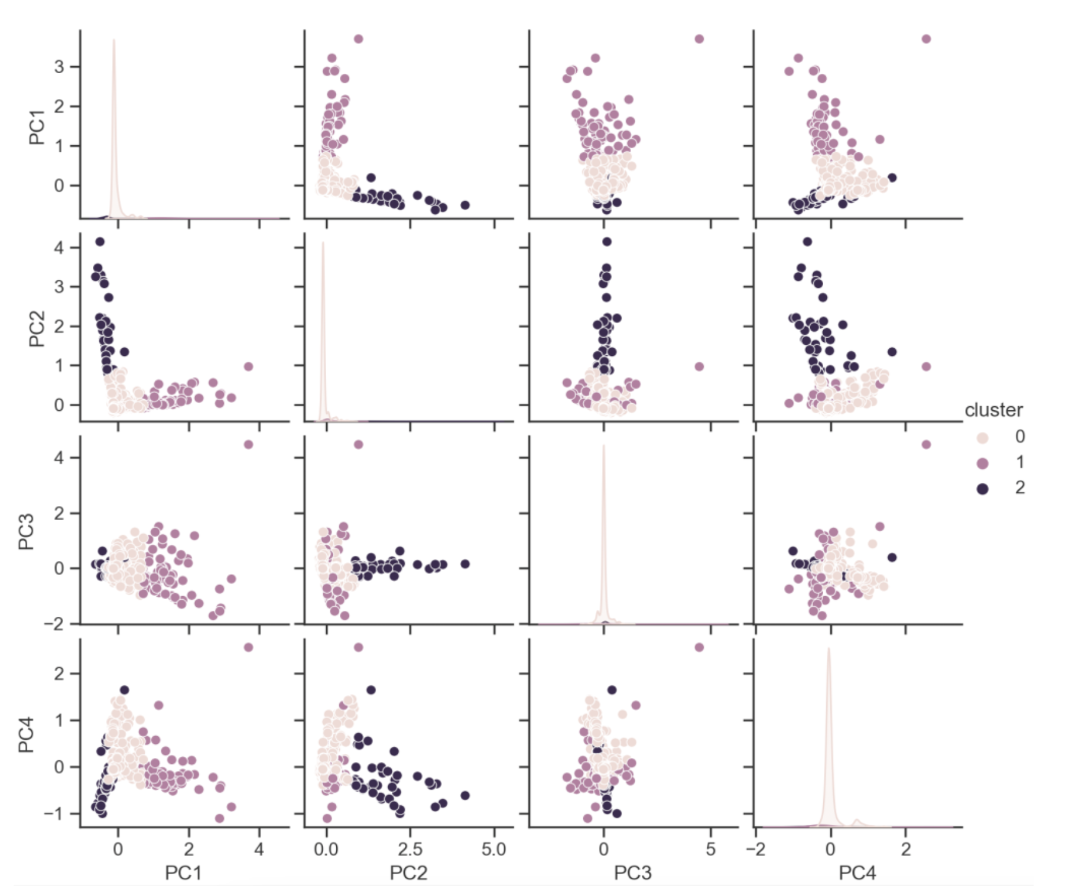
K-means clusters with 4 PCs

Slide 20
Findings
We have scraped data of 1629 with products 2959 ingredients from 4 food supplements websites in Ireland
Out of 1629, 209 products contain 23 potentially harmful botanicals in total according to EFSA.
Logistic regression with feature selection methods could not perform well. Our assumption of this behavior is due to loss of data
Models performed well with oversampling as it counters our imbalanced dataset
Penalized regression performed best among all others. Reason could be that it uses entire dataset.
Ridge performed better with recall of 0.37, than lasso as ridge doesn’t make coefficients of less significant features to zero as lasso
K-means with principal components was able to cluster data into 3 groups to a certain extent. Out of these, a product in cluster 2 has a higher chance of being harmful than others.

Slide 21
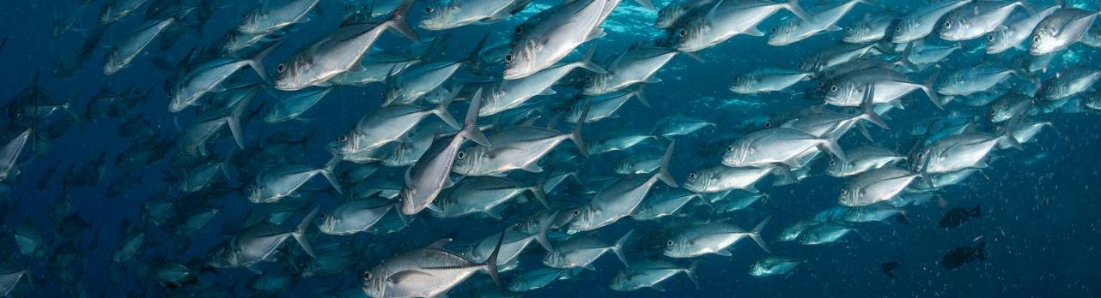
Thank You

